Slide 1




Computer Science CS033a
Multimedia and Communication
Lecture #6
Website Creation Stages and Dreamweaver Concepts

Slide 2
Today’s Lecture
LAST LECTURE #5:
Intro to Web Design
  How do I get started?
  IP Addresses,
  Domain Names, Subdomains
  Web Hosting
THIS LECTURE
#6:
Web Design
Criteria
Bad Designs
Effective Designs
Website Creation stages
Continue

Slide 3

Okay!
Got my Domain Name
Internet Service Provider
… Start Designing
your Website
because……

Slide 4

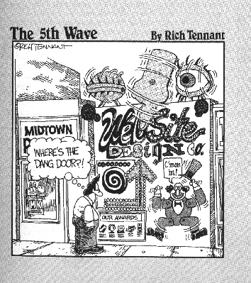
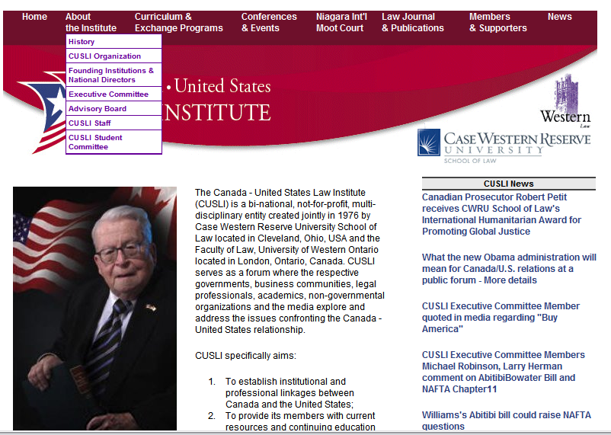


Slide 5
Could you be the next
17 yr old millionaire?
(it is too late!)
http://youtube.com/watch?v=So9doa8vuNw
http://www.whateverlife.com
$$$$$
HOW TO MAKE GOOD COFFEE:
http://makegoodcoffee.com/

Slide 6
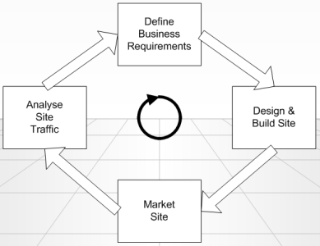

Website Development Stages
Stage 1: Planning & Design
Meeting with Client
Be prepared
Do your homework
Learn about the business
Ask for brochures etc.
Ask questions
Planning &Design
1
Stages of creating
a Website
2
Publish
3
Maintenance
4
Notes:
Publish aka FTP

Slide 7
Website Development Stages
Stage 1: Planning & Design
INFO GATHERING
Ask questions and listen
Meeting with Client
Learn as much as you can
→ will help with website design
Who is the audience?
Company image?
Will the company focus change over a year?
Logos
Graphic images
Check Competitor sites
Web Domain
Web Host
Websites they like
Menu options – top or side
Content – written ?
Deadlines
Maintainer

Slide 8
Effective Website Designs?
Think of a website that you have either loved or hated. What are the things about it that made you love it OR hate it?
http://www.lingscars.com
http://www.parktravel.com/
http://www.jerrypippin.com/
http://www.indiana.edu/~ensiweb/
http://www.ospe.on.ca/?page=gov_board
http://www.digitalhollywood.com/
http://www.flatbush.org/
http://www.siphawaii.com/

Slide 9
Effective Website Designs?
Bad Design Features
Too slow
Navigation confusing – different spots, scrolling
Difficulty reading screen
Ugly design- no color balance or white space
Broken links
Scrolling horizontally to see whole page width
Spelling mistakes
Stale content
Useless information
Blinking, animation

Slide 10
Effective Website Designs?
More Designs
So let’s look at these designs -- Like or dislike?
http://www.avanttravel.com
http://www.magnoliatravelagency.com/
http://www.gizishotel-santorini.com
http://www.robarts.ca/
http://www.mandywebster.com
http://www.zincbistroaz.com/index.html

Slide 11
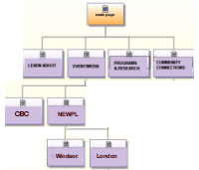
Effective Website Designs?
Good Features
Speed – limit graphics- optimize
Easy to use
Navigation – continuity on every page, homepage links
3-Click Rule
Consistent design – colors, buttons, layout
Colors – effective colors, contrast
Never underline unless a link
Webpage width should accommodate
lower resolution
Content is interesting and easy to read
Refresh material – update frequently
Avoid animation, blinking text etc.
Optimized for search engines
Check spelling
Notes:
Exam question!-Optimize images by resizing them in Photoshop save it then bring it into webpage
Exam question!- 3-Click RULE ! , means from time I land on homepage, 1 click to some page, then another level, then another level, usually 1 or 2 click max when making websites!
Exam question!- never underline unless a link!
-not checking on website assign to see if we optimized unless it’s really slow, noticeable

Slide 12
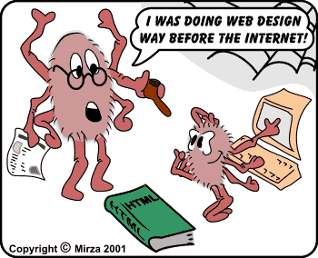
Effective Website Designs?
Design Strategies
KISS Principle
Consistency
Color
Balance
Easy to Navigate
Notes:
Keep
It
Simple
Stupid
(KISS)

Slide 13
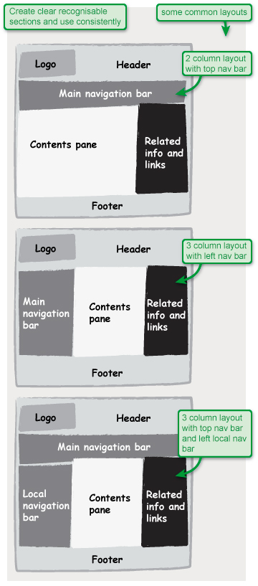
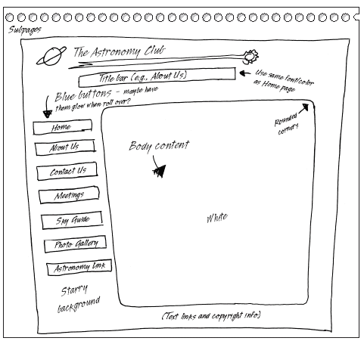
How to Start a Website Design?
Each webpage must
have the same look!!
Website
Website
Website
Website
https://www.microsoft.com/mspress/books/sampchap/6403/0-7356-18607-04.gif
http://usability.coi.gov.uk/themes/page-layout/assets/images/1a-1.jpg
Notes:
All based on tables

Slide 14
How to Start a Website Design?
Identify:
Homepage + # pages
Menu – top or side WHY?
Will there be dropdowns under the menus? (this will affect your folder layout)
Pick a colour scheme
Banner
  Will the menu be part of the banner?
  Make it about 900 or 1000 pixels wide, don’t make it too tall. (max 150- 200)
Sketch it out on paper
http://usability.coi.gov.uk/themes/page-layout/assets/images/1a-1.jpg
https://www.microsoft.com/mspress/books/sampchap/6403/0-7356-18607-04.gif

Slide 15
Things to Remember, especially for Assignment 3 and Assignment 4!
Banner and Menu in the same place on every page.
No scrolling horizontally
(accommodate 1024 x 768 resolution)
Consistent color scheme
Keep the layout fairly consistent on every page
Always have a home button
Long pages should have a
“Back to Top” button
BALANCE FONT SIZE OF BUTTONS VS TEXT
https://www.microsoft.com/mspress/books/sampchap/6403/0-7356-18607-04.gif
http://usability.coi.gov.uk/themes/page-layout/assets/images/1a-1.jpg
Notes:
Back to Top –use it for assign3- has marks for it

Slide 16
Designing your Website
STAGE 2: Implementation Stage
Implementation
Stages of creating
a Website
Publish
Maintenance

Slide 17
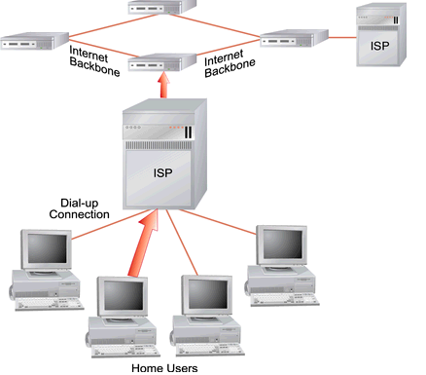
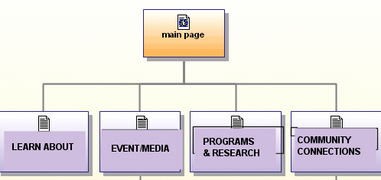
Designing for the Web:
What do I need to know?
Web Page
HTML – Hyper Text Markup Language
Computer instructions used to create web pages
Web Site
Collection of webpages created and maintained by an organization/individual
Web Server
A computer that stores web pages
and makes them available for people to see on the Internet
Web Browser
program that allows you to view the Internet
Ie.(PC) Internet Explorer, Mozilla Firefox, Netscape, Chrome
  (Mac) Safari, Camino
Notes:
KNOW TERMINOLOGY FOR EXAM!!
Basis of webpage is HTML, this is what browser reads! Dreamweaver has html in the background (split screen mode..)

Slide 18
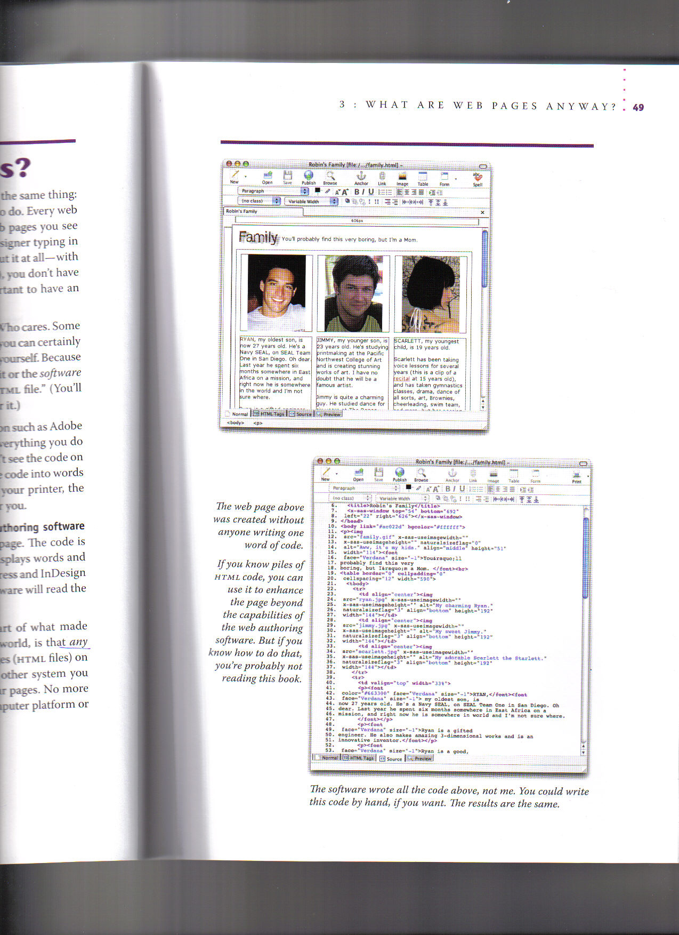
Intro to the Web:
How Do I make a Webpage?
Web Page (.html or .htm)
HTML - Hyper Text Markup Language
Computer instructions read by browser
Any computer can read HTML files –cross platform
Choose to write the code itself - Use Notepad
Use of web authoring software ie. Dreamweaver, FrontPage etc
Extracted from: The Non-Designer’s Web book by Robin Williams and John Tollett
Notes:
.html means webpage
.htm is older versions

Slide 19
Build with web authoring software
WYSIWYG
DW Records HTML as you are building
Extracted from: The Non-Designer’s Web book by Robin Williams and John Tollett

Slide 20
Intro to the Web:
Web Page File Names
.html, .htm (Hypertext Markup Language)
  .htm – DW versions prior to version 8
  .html - DW 8 version and later uses this extension
  The code is what the browser uses to display the webpage on your screen
.shtml
  “Server Side Includes” means that html document has special commands for the server to process ie. Other data to pull in from server, counter processing etc.
  add some extra stuff from the server before displaying the page to the client”
.php, .asp, .cgi → extra stuff that is brought in also from the server, allows for use of data in a database on the server, more complex form manipulation. asp is a Microsoft technology
Notes:
.shtml has to go to server to grab something and put it on your webpage , database, inventory
Common names

Slide 21
Intro to the Web:
Types of HTML Tags
Most HTML tags start tag and end tag
<tr> xxxx </tr>
<body>
xxxxxxx
</body>
<table> xxx </table>
Rules:
<tag> xxxxx </tag>
Section tags
  <html>, <body>, <head>, …
Formatting tags
  <b>, <ul>, <i>,<p>,<h2>,</b>,</h2>, …
Link tags
  <a href=“http://www.msn.com”>, <a>, …
Placeholder tags (standalone or unpaired tags)
  <img src=“ “>, <hr>
<tr>
xxxx
</tr>
Notes:
Not testing html but could ask is this html tag
-usually have beginning tag and end tag
-closing tag starts with forward slash!!,, backslash is wrong!
-right hand side of screen not testable

Slide 22
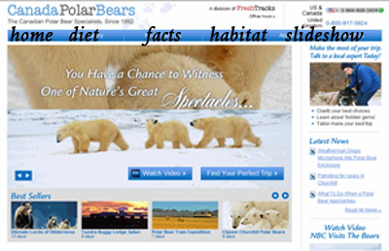
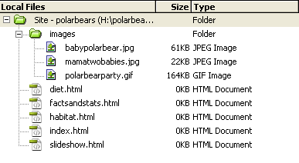
Web Site Layouts: Simple Layout
Example 1: Simple layout
Assume we are making a website about Polar Bears. The folder structure (folder is called polarbears on drive H:)
might look like this:
Create a folder called “polarbears”
(known as “root directory”)
Inside the folder “polarbears”
.folder called “images”
homepage “index.html”
All webpages: habitat.html, diet.html ..
Panther is case sensitive
USE LOWER CASE
Notes:
Went to 6b here to talk about assign3 more

Slide 23
Links for the simple structure
Assume the domain name for this site is: ArcticAnimals.org
SCENARIO 1:
If you upload only what’s inside the
folder “polarbears” (images folder, diet.html etc...)
directly to the root level of the server
To view the website from browser:
  http://www.ArcticAnimals.org/
  http://www.ArcticAnimals.org/index.html
To view the habitat page you would type:
  http://www.ArcticAnimals.org/habitat.html

Slide 24
Links for the simple structure
Assume the domain name for this site is: arcticanimals.org
(notice domain names are case insensitive)
SCENARIO 2:
If you create a folder “polarbears”
on the server upload the webpages/images etc,
→ view the website from browser:
  http://www.arcticanimals.org/polarbears
  http://www.arcticanimals.org/polarbears/index.html
To view the habitat page you would type:
  http://www.arcticanimals.org/polarbears/habitat.html

Slide 25
I CAN UPLOAD THIS STRUCTURE
TO ANY SERVER
Assume you are uploading the folder itself “polarbears” and its contents under it
Uwo server:
www.uwo.ca/polarbears/index.html
www.uwo.ca/polarbears
Upload it to your publish area on panther
http:// publish.uwo.ca/~vtryphon/polarbears
Upload it to Computer Science server: (gaul)
http://publish.gaul.csd.uwo.ca/vtryphon/polarbears

Slide 26
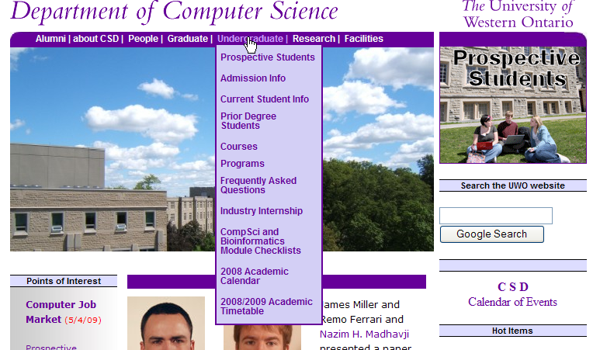
Web Site Layouts:
More Complicated layout
Sometimes websites have many submenus and have lots of web pages.
In this case we need a more complicated folder structure
  BUT it is not really that much more complicated, just one main folder with subfolders
  Each sub folder contains it’s own index.html and images subfolder

Slide 27
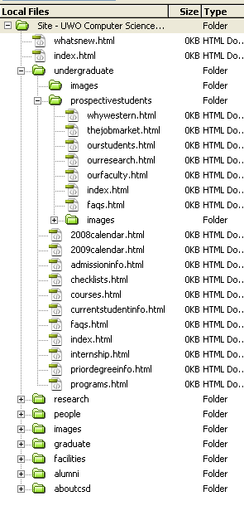
1
3
Are these the same?
  http://www.csd.uwo.ca
  http://www.csd.uwo.ca/index.html
1
2
2
  http://www.csd.uwo.ca/undergraduate
  http://www.csd.uwo.ca/undergraduate/index.html
3
http://www.csd.uwo.ca/undergraduate/prospectivestudents
http://www.csd.uwo.ca/undergraduate/prospectivestudents/index.html

Slide 28

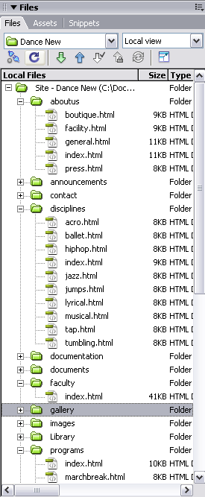
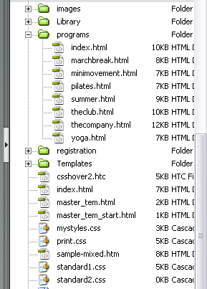
Do they point
to the same file??
www.thedancemovement.ca/aboutus/index.html
www.thedancemovement.ca/aboutus
www.thedancemovement.ca/disciplines/index.html
www.thedancemovement.ca/index.html
homepage

Slide 29
Designing your Website
Stage 3 - Publish
When the web site is completed you will need to move files to a Web Server
Web Server → the computer that runs software which holds the web pages and serves up (delivers) web page to the client. This computer must be connected to the Internet.
Need Web space
Use FTP software
(File Transfer Protocol)
Stages of creating
a Website
Publish
Maintenance
Question: What is the software you learned in in the labs to move the web pages to the web server?
Question: What is the name of the web server machine at Western?

Slide 30
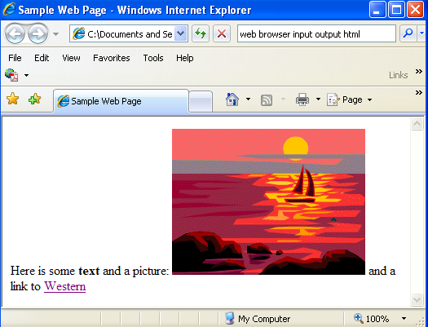
How are webpages displayed?
Designing your Website
Stage 3 - Publish
<html>
<title>Sample Web Page</title>
<body>
Here is some <b>text</b> and a picture: <img src="sunset.gif">
and a link to <a href="http://www.uwo.ca">Western</a>
</body>
</html>
Input to
Web Browser
______________
Once you have uploaded your web site to a web server you MUST test your web site by opening it in a Web Browser
Web Browser
→ software/program that displays formatted web pages to the client on their monitor)
Internet Explorer, Firefox, Chrome, Safari etc...
Output to
Web Browser
_____________________

Slide 31
Web Browser
Question: What is the input we give a web browser?
Question: What is the output from the web browser program?
Question: Can you name 3 web browser programs?
Question: Does anyone know how you look at the html that was used to create the page currently displayed in the browser?

Slide 32
Designing your Website
Stage 4 - Maintenance
Who is the maintainer?
Will need training
Update frequently/ how often?
Backup your information in case of corruption
Stages of creating
a Website
Publish
Maintenance

Slide 33
Next week
LECTURE - Part6B
(IMPORTANT LECTURE Don’t miss it!!)
Working in Dreamweaver and understanding features, their role, and how to work with them
Tips and Advice
Discuss Assignment 3
Demonstrate on building a website in 10 minutes.

